Slide 1
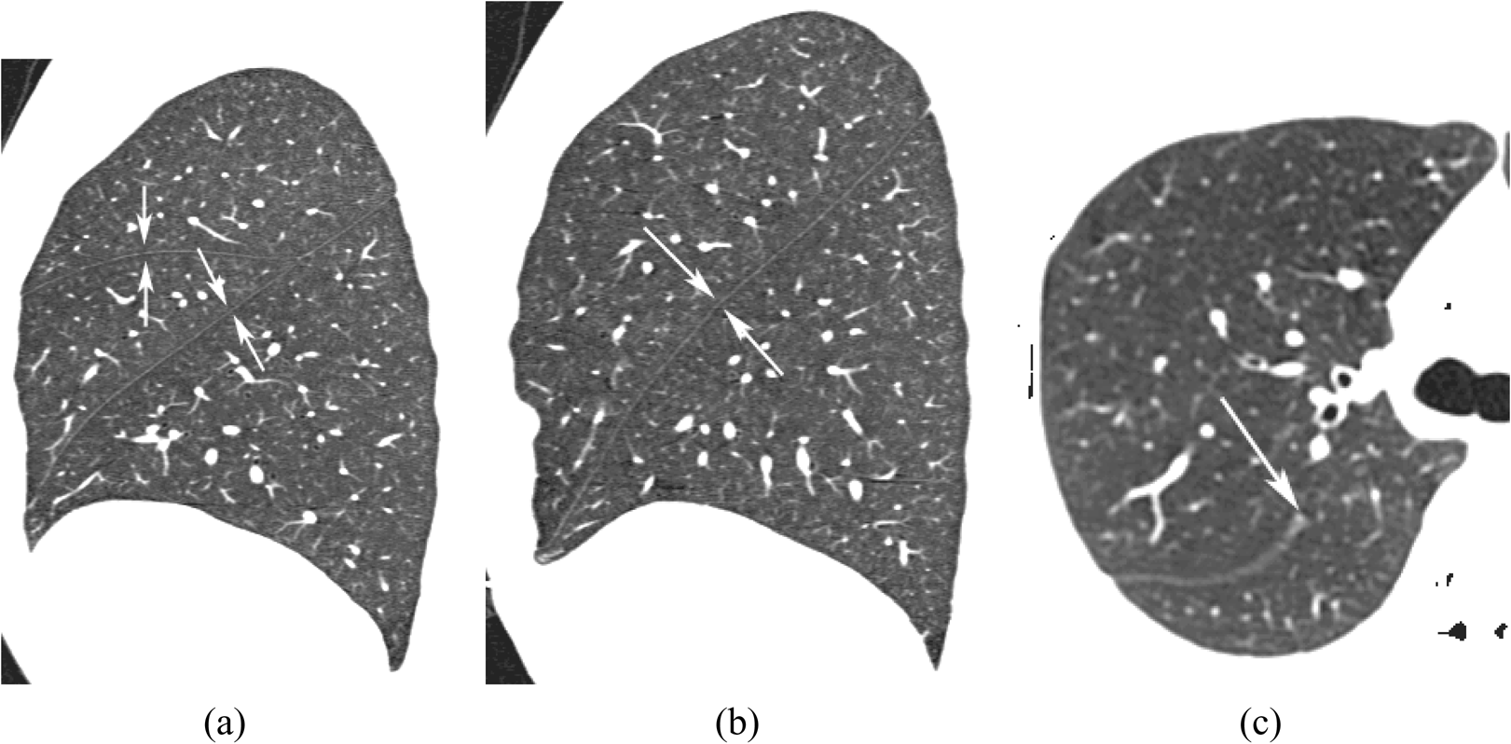
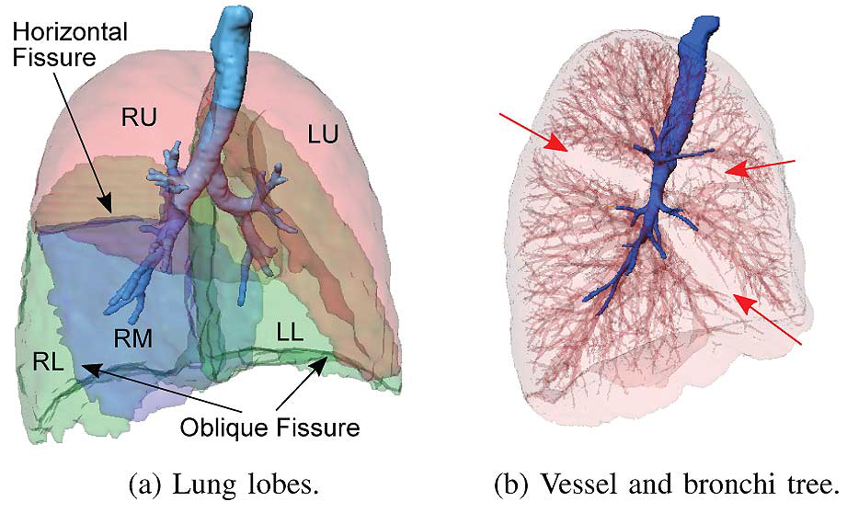
The challenges of pulmonary lobe segmentation and possible solutions
Yuwen Zhang, Dr. Alys Clark, Professor Merryn Tawhai, The University of Auckland, New Zealand
Background
The human lung is divided into five distinct anatomic compartments called lobes. The separating junctions between the lobes are called the lobar fissures. The left lung consist of the upper and lower lobes, which are separated by the left oblique (major) fissure. The right lung consist of the upper, middle, and lower lobes, which are separated by the horizontal (minor) fissure and the right oblique (major) fissure (see Fig. 1) [1].
Some pulmonary diseases are more prevalent in specific anatomic regions of the lung. Thus, segmentation of the lobes and understanding the tissue and functional characteristics of the lobar parenchyma is clinically important for disease classification and may provide insights into the basic pathophysiology of lung disease.
Challenges of pulmonary lobe segmentation
Anatomical variation associate with different age, sex and body type [2]
Fuzzy appearance of fissures on CT images, in particular in the presence of abnormalities near the fissures
Even in patients with normal lung parenchyma the fissures are often not complete(examples are shown in Fig 2)[3].
Summary
The key aim of our work is to implement an interactive method that realises a fast and accurate segmentation and correction based on a given standard PCA model.
incomplete fissure detection and the realization of a more timesaving algorithm is the main point for the next step of our work.
A comparison between the novel method and previous study of other research group is necessary to verify the practicability and effectiveness.
(a) (b) (c)
Fig.2: (a) the right oblique and horizontal fissures (b) the left oblique fissure. (c) an incomplete right oblique fissure.
Possible solutions
To overcome these challenges, we plan to segment pulmonary lobes using a PCA-based model. An average lobe boundary model based on PCA through sampling lobe boundaries (including fissure surfaces) of a set of training data (about 40 subjects, all healthy divided into old and young group) is generated. The use of PCA shape modeling provides a convenient way to identify target regions which are highly likely to represent fissure surfaces. With the help of the average model, we are able to eliminate some non-fissure structure and capture variation of lung lobe across a population which makes the automatic lobe segmentation and fissure detection more efficient. Among the variation range of lobe boundary model (ROI), a fissure detection algorithm (e.g. Hessian matrix or marching cubes algorithm, MCA) will be provided to find the fissure location accurately with an arbitrary input image. For cases with some incomplete fissures, the “smooth” interpolation and extrapolation by the use of implicit functions may be helpful to extend the fissure surfaces to lobe boundary smoothly and naturally. A 3D optimal surface detection will be performed around the variation of PCA model to help refine the lobe boundaries.
References
[1] Lassen B.et al. IEEE TMI. 2013, 32(3), pp. 210-222
[2]Ross JC. et al. J. Med. Phys. 2013, 40(12), 121903
[3]Ukil S et al. 2009, IEEE T-MI,28(2),pp. 202-214
CT
New Input Image
Lobe Surface Sampling
Lobe Boundary Model Construction (PCA)
Lobe Boundary Refinement
Lobe Segmentation Result
Fig.1: Renderings of the anatomy of the lungs. It shows that the lungs are subdivided into the right upper (RU), right middle (RM), right lower (RL), left upper (LU), and left lower (LL) lobe.
Training Data
Fissure Detection
Fig.3: Overview of the method steps for fissure detection and lobe segmentation

